Slide 1
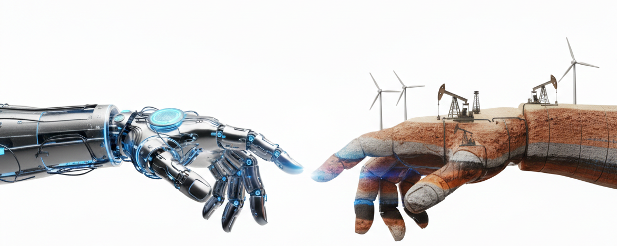
Machine Learning for Subsurface engineers
Dursun Dashdamirov, Nadir Zeynalli, Vugar Dunyamaliyev
Session VI

Slide 2
Machine Learning for Subsurface engineers
This program is dedicated to applications of Machine Learning on various subsurface disciplines, including geology, geophysics, drilling, petroleum, and reservoir engineering.
Topics
Predictive Modeling with subsurface data
Supervised Learning (Regression)
3. Supervised Learning (Classification)
4. Unsupervised learning
5. Neural Networks
6. Generalization, Uncertainty Quantification, Explainability
7. Capstone Project
Format
Online, with hands-on math/programming exercises
6 lectures in 6 weeks + 1 lecture for presentations
15 February - 29 March (Sundays, 6-8 pm Baku time)

Slide 3
5. Neural networks
Dursun Dashdamirov, Nadir Zeynalli
5.1 Forward pass
5.2 backpropagation
5.3 training dynamics
5.4 modern architectures

Slide 4
5.1 forward pass

Slide 5
5.2 backpropagation

Slide 6
5.3 training dynamics

Slide 7
5.3 modern architectures
This section covers relatively modern structures including autoencoders and

Slide 8
References and resources

